Slide 1
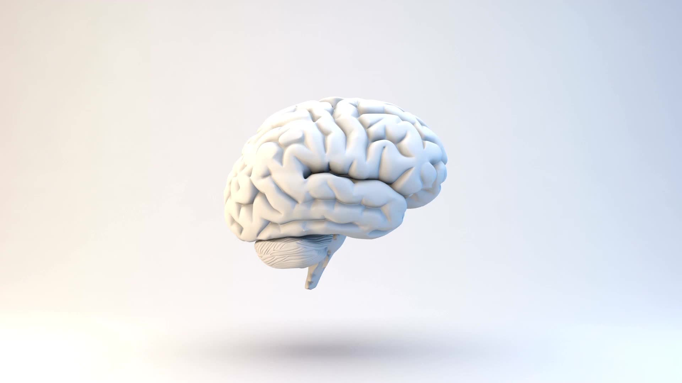
Conway’s Game of Life

Slide 2
History
the problem was first presented in the 1940s by renowned mathematician John von Neumann
developed by John Conway in 1970
best-known example of a cellular automaton
zero player game

Slide 3
Applications
Studying the patterns of Life can result in discoveries in other areas of math and science.
The behavior of cells or animals can be better understood using simple rules. Behavior that seems intelligent, such as we see in ant colonies might just be simple rules that we don't understand yet
Traffic problems might be solved by analyzing them with the mathematical tools learned from these types of simulations
Computer viruses are also examples of cellular automata. Finding the cure for computer viruses could be hidden in the patterns of this simple game.
Human diseases might be cured if we could better understand why cells live and die.
Exploring the galaxies would be easier if machines could be invented that could build themselves. Imagine sending a probe to Mars that could build a copy of itself. Although this is theoretically possible, it hasn't been invented yet!

Slide 4
It is not immediately obvious whether a given initial Life pattern can grow indefinitely, or whether any pattern at all can.
Conway offered a $50.00 prize to whoever could settle this question. In 1970 an MIT group headed by R.W. Gosper won the prize by finding the glider gun that emits a new glider every 30 generations. Since the gliders are not destroyed, and the gun produces a new glider every 30 generations indefinitely, the pattern grows forever, and thus proves that there can exist initial Life patterns that grow infinitely.

Slide 5
Rules
describe the evolution of the grid:
Birth: a cell that is dead at time t will be alive at time t+ 1 if exactly 3 of its eight neighbors were alive at time t
Death: a cell can die by:
Overcrowding: if a cell is alive at time t+ 1 and 4 or more of its neighbors are also alive at time t, the cell will be dead at time t+ 1
Exposure: If a live cell at time t has only 1 live neighbor or no live neighbors, it will be dead at time t+ 1
Survival: a cell survives from time t to time t+ 1 if and only if 2 or 3 of its neighbors are alive at time t.

Slide 6

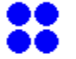
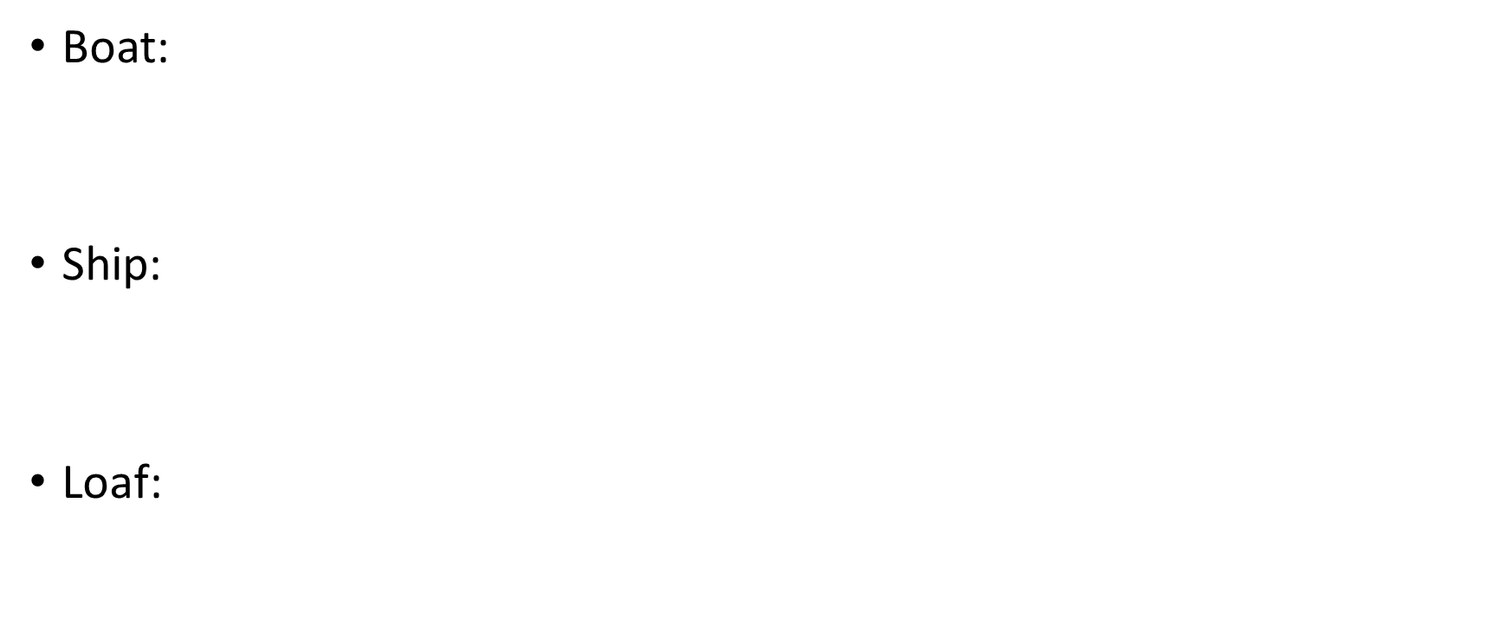



Types of “life-forms” Still Life
a stable, finite and nonempty pattern. Examples include various shapes of ponds, and other patterns shown below:
Block:
Beehive:

Slide 7
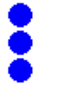

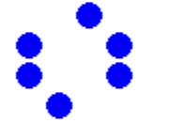
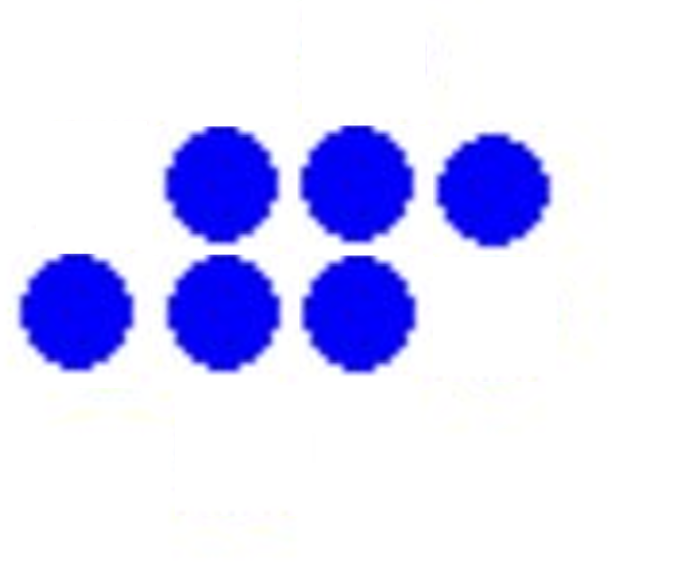
Periodic Life Forms/Oscillators: the following life-forms oscillate periodically
Period 2:
Blinker:
Toad:

Slide 8
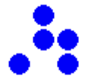
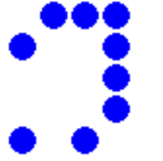
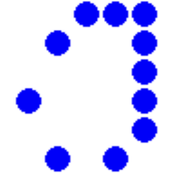
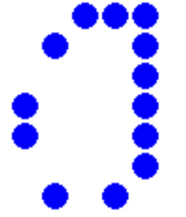
Oscillators of many more periods exist:
Spaceship: moves across the game board
Glider: simple 5-cell pattern that repeats itself every 4 generations, but is offset diagonally by one cell. The smallest and most common spaceship. The glider is said to travel with speed c/4.
Light Weight Space Ship (LWSS) (speed c/2):
Medium Weight Space Ship (MWSS):
Heavy Weight Space Ship (HWSS):

Slide 9
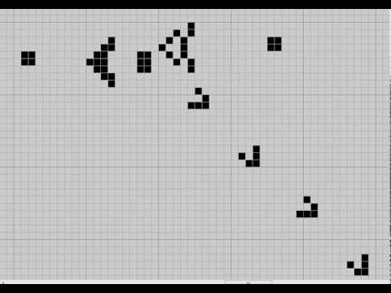
Other life form – Gosper Glider Gun
was found by Bill Gosper in 1970, being the first known pattern in Conway's Game of Life to exhibit infinite growth
it emits a steady stream of gliders
it has a period of 30, as it emits a new glider ever 30 generations.

Slide 10
Predicting the future
It is not easy to tell from looking at an initial Life pattern exactly how it will evolve. For instance, in looking at what happens to a straight line of n live cells as a start configuration:
n= 1,2: fades immediately
n= 3: Blinker
n= 4: becomes a Beehive at time 2
n= 5: traffic lights at time 6
n= 6: fades at t= 12
n= 7: makes a symmetric display before terminating in the Honey Farm (see picture in Winning Ways)
n= 8: gives 4 blocks and 4 beehives
n= 9: makes two sets of traffic lights
n= 10: turns into pentadecathlon, with life cycle of 15
n= 11: becomes two blinkers
n= 12: makes two beehives
n= 13: turns into two blinkers
n= 14,15: vanish completely
n= 16,17: becomes 4 blocks
n= 18,19: vanish completely
n= 20: makes 2 blocks

Slide 11
Reversing The Game of Life
Just applying the rules described earlier can result in a complex system
Kaggle has launched a competition whose goal was to “reverse the time arrow” in Game of Life
we need to predict the starting board that, when evolved, will resemble the end board state as much as possible

Slide 12
How to solve the problem
Genetic Algorithms
CNN
SVM
Random Forest

Slide 13
Chosen solution Genetic Algorithm
method for solving both constrained and unconstrained optimization problems based on a natural selection process that mimics biological evolution
solution domain must have genetic representation (i.e., one can define mutation, crossover, and other operators on candidate solutions)
fitness function must be defined for evaluating candidate solutions

Slide 14
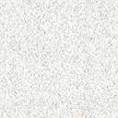
Steps
-> Initialize population
While condition not met:
1. Perform Selection
2. Perform Mutation
3. Perform Crossover

Slide 15

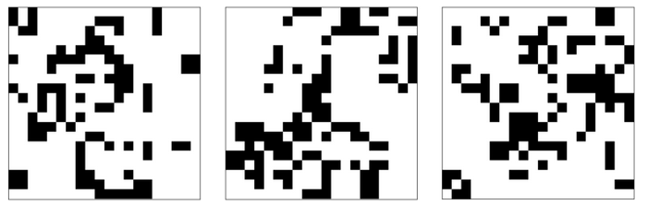
Initialize population
Each individual is a 20x20 board that represents candidate start configuration
Each cell has equal chance of being “alive”, and we’re advancing the whole board by five iterations (known in challenge documentation as “warming steps”) to match competition’s distribution.

Slide 16
Steps
Initialize population
While condition not met:
-> 1. Perform Selection
2. Perform Mutation
3. Perform Crossover

Slide 17
Selection
Selection operator is responsible for picking the best individuals to proceed into the next generation
In order to resemble natural selection more closely, we still allow for a small chance for sub-optimal individuals to live on and mate.

Slide 18
Steps
Initialize population
While condition not met:
1. Perform Selection
-> 2. Perform Mutation
3. Perform Crossover

Slide 19
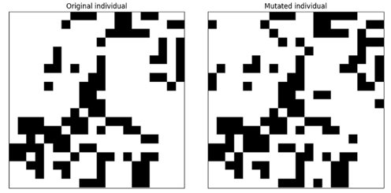
Perform Mutation
Mutation operator will introduce random variability into our population
It does this by randomly selecting cells and switching their state
Combined with selection operator, this will make our algorithm perform a hill-climbing optimization.

Slide 20
Steps
Initialize population
While condition not met:
1. Perform Selection
2. Perform Mutation
-> 3. Perform Crossover

Slide 21
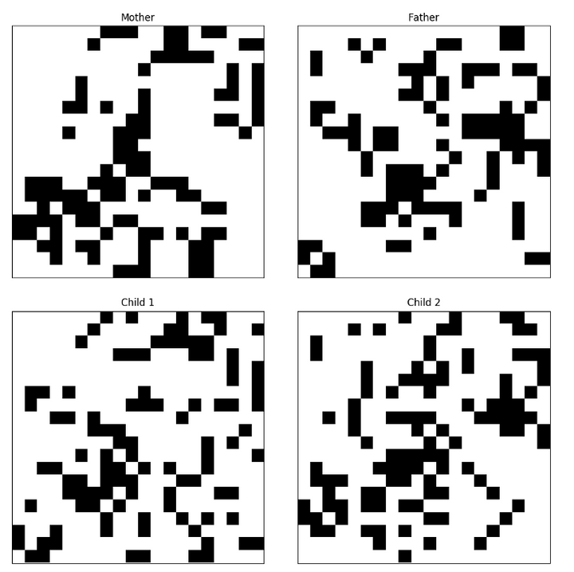
Perform crossover
Crossover operator will recombine two genes, simulating mating of two individuals
The result is two children, each with half of the genes (cell states) from father and other half from mother

Slide 22
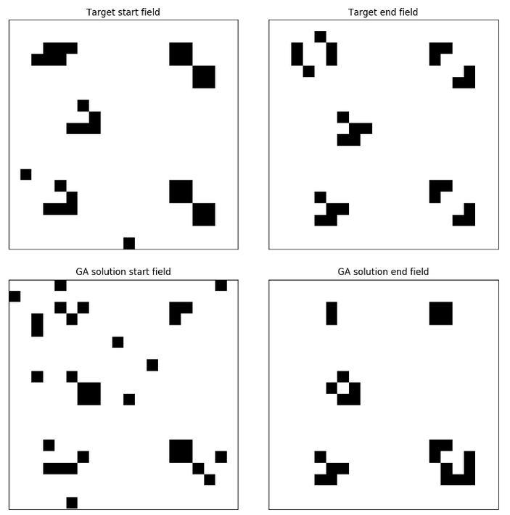
Solving
The final solution will be chosen as the individual that has the minimum Mean Absolute Error
The solution is not unique as there are more templates that can result in the same state

Slide 23
Conclusions
After running the algorithm for a population of 200 candidates, the best candidate had a fitness score of 0.91
Genetic Algorithms are currently on the second position in the Kaggle contest, which shows us that further improvements of the algorithm is possible
Solving The Game of Life has many applications, some of which reflect also on the reverse of it

Slide 24

References
http://www.math.com/students/wonders/life/life.html
https://www.kaggle.com/c/conway-s-reverse-game-of-life/
https://nbickford.wordpress.com/2012/04/15/reversing-the-game-of-life-for-fun-and-profit/
http://web.mit.edu/sp.268/www/2010/lifeSlides.pdf
https://medium.com/@ptyshevs/rgol-ga-1cafc67db6c7

